Slide 1
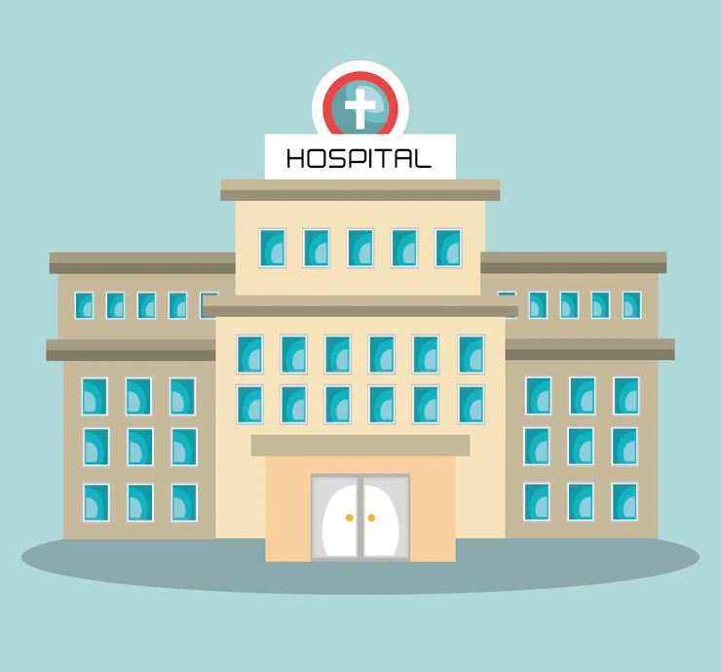
UNIFIED MEDICAL RECORD
graduation project

Slide 2
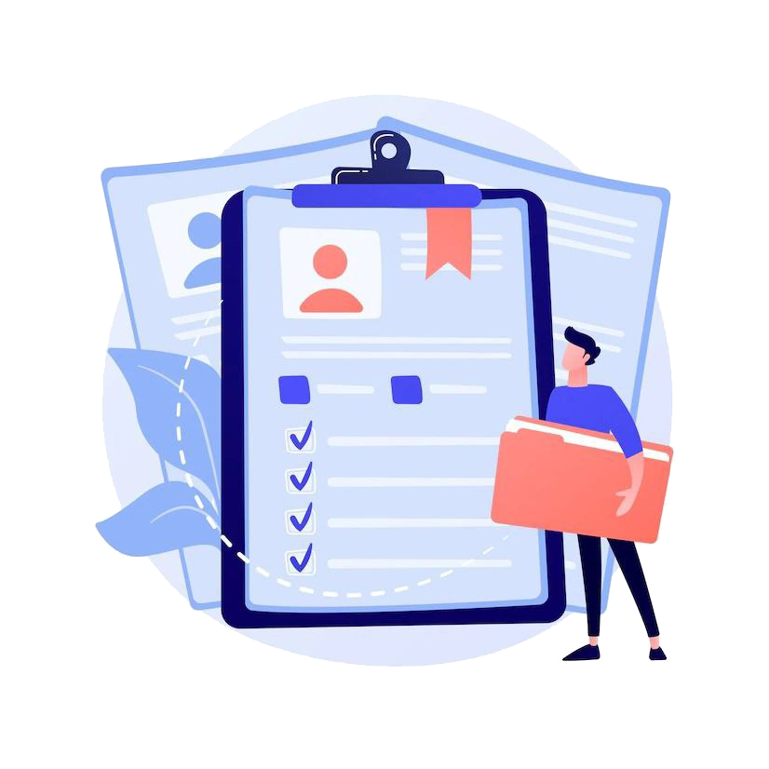
Agenda – 7 Items
1) Problem about Medical Record.
2) our idea.
3) The purpose of the idea.
4) Advantages.
5) Our 4 Systems.
6) Our Website and Mobile App.
7) Obstacles we faced.
8) Our future plans.
9) Conclusion.
10) Project video.

Slide 3
problem
All doctors face a big problem with their patients, which is the lack of a good diagnosis, and this problem lies in some reasons, such as:
1-Not explaining the doctor's medical history well.
2-The doctor's lack of knowledge of the patient's chronic diseases.
3-Not knowing what medicines were taken before.

Slide 4
Idea
The idea is (a unified medical record) that aims to make it easy for the patient and the doctor to have all the information in one place and a reliable place from it as there are many doctors who find it difficult to diagnose, and sometimes they make a wrong diagnosis because there is not enough information about the patient’s previous condition and medicines.

Slide 5
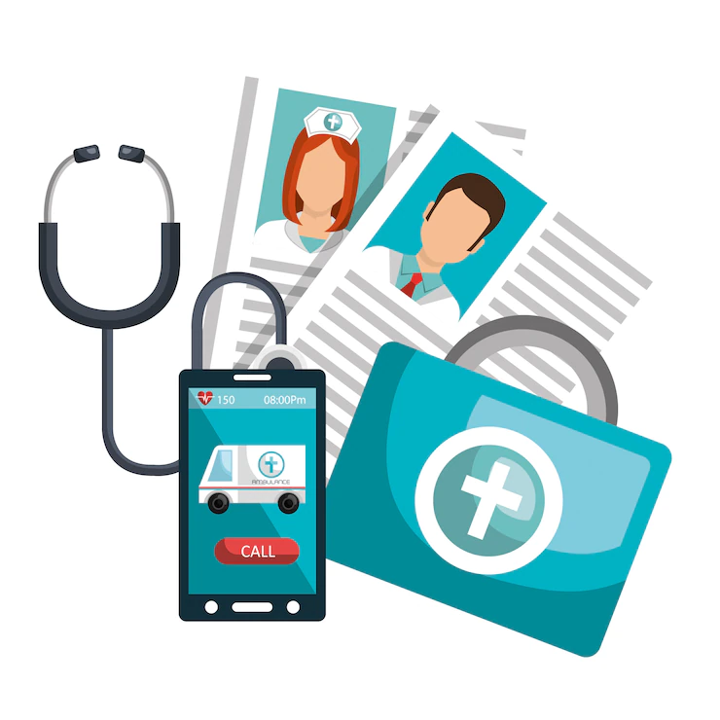
Hence,
The purpose of the system is to make it easier for the doctor and the patient to understand the patient’s previous and current health status and the medicines that’s taken once in a person’s life, as it is difficult for the patient to mention the matter to the doctor because he does not know the name of this medicine. One of our reasons for making this system is to rectify this error in order to preserve the patient's life.
All that the patient has to do is save his identification card to make it easier for every doctor to know everything related to his medical history.
We are able to link all the patient's places to make it easier for any doctor to know the previous medical history of any patient

Slide 6
Advantages:
1-make it is easier for the doctor and the patient to understand the patient’s previous and current health status.
2-it saves time and effort for the patient to register on the application.
3-it is easy for the patient and the doctor to have all the information in one place and a reliable place from it.
4-As for the doctors they have the right to change the appointments or see them, and they have the medical record of the patient when needed.

Slide 7
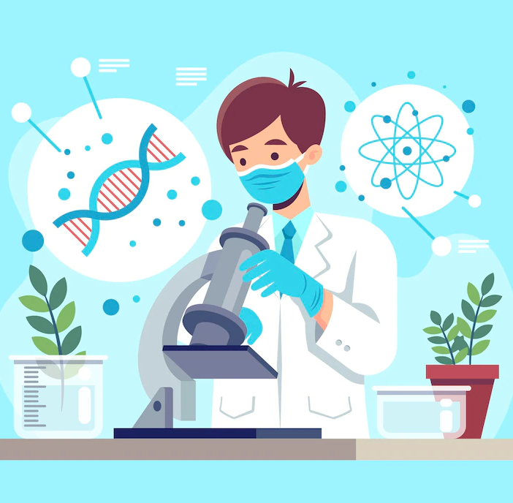
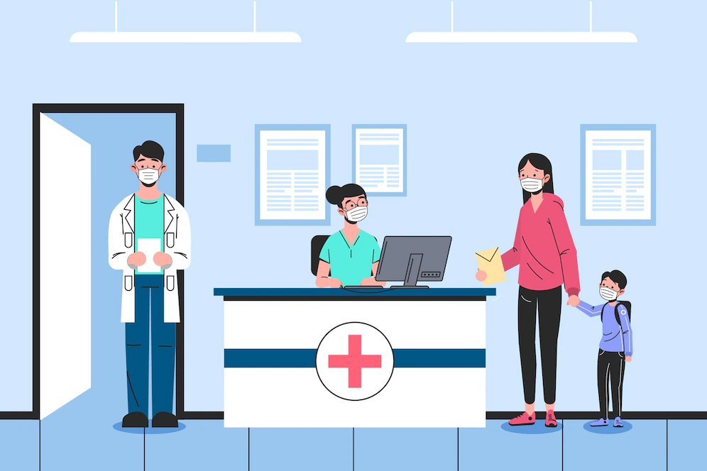
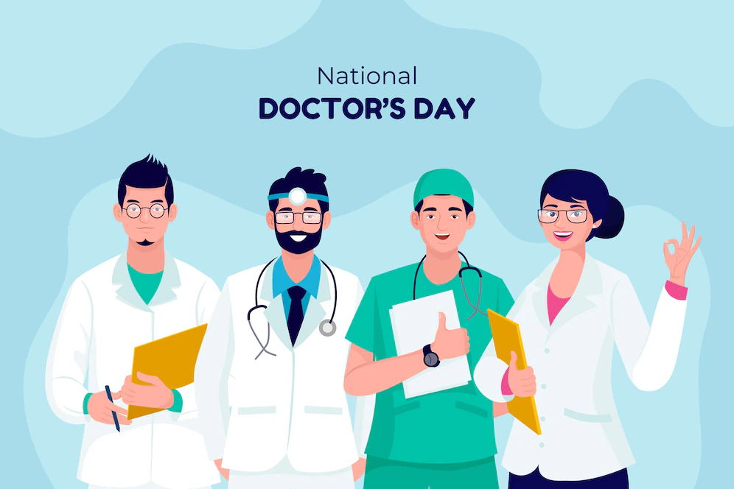
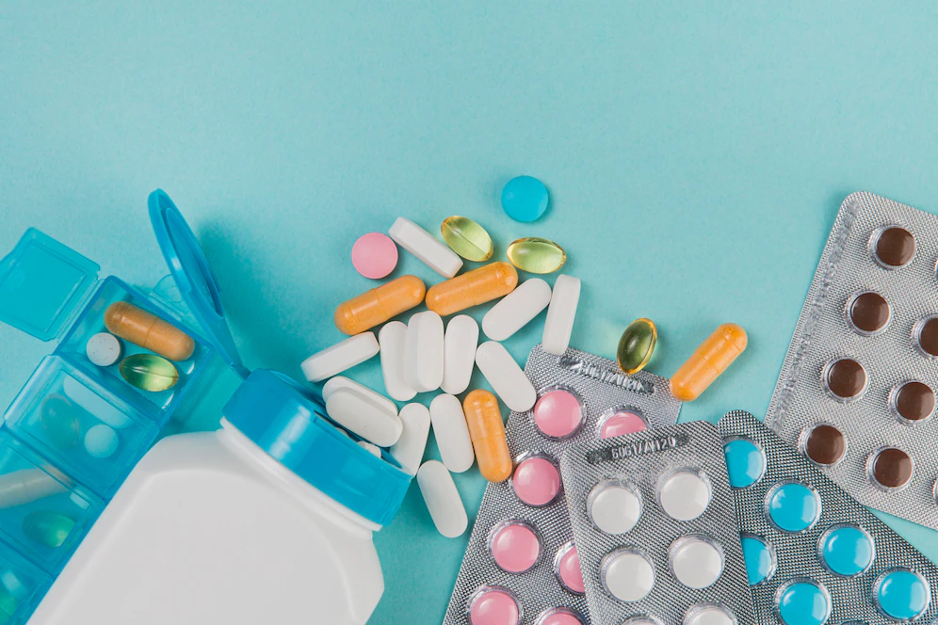
Project includes 4 systems
Hospital Reception
laboratory
pharmacy
Clinics
Eye Clinic, Dental Clinic

Slide 8
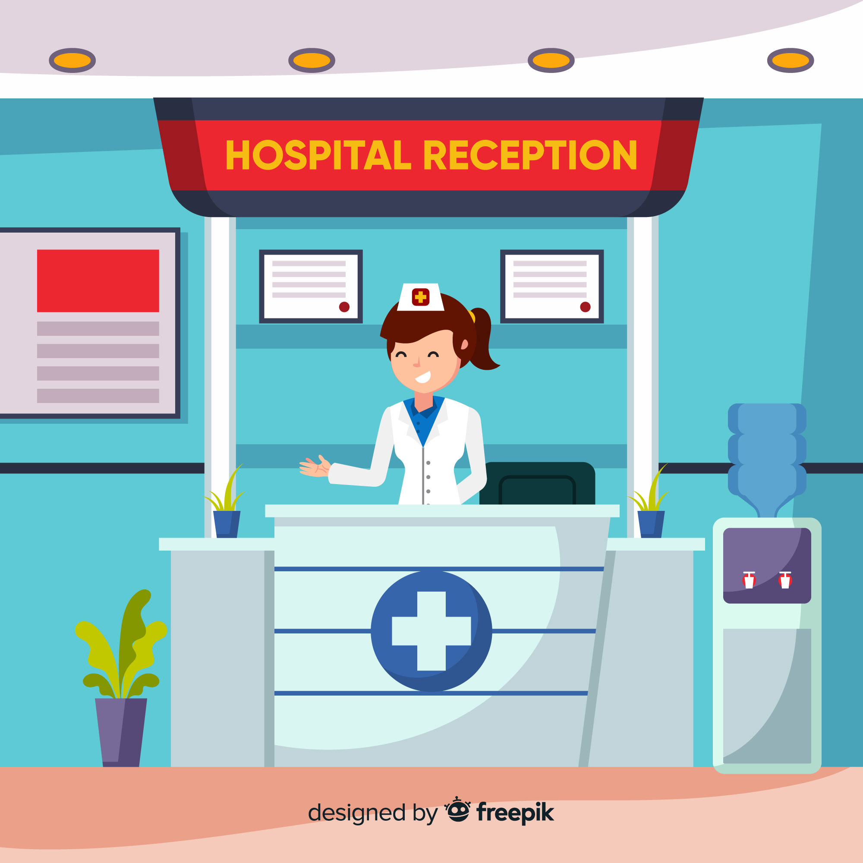
Hospital reception system:
The hospital reception: Doctor is the only one capable of making a new medical record for the patient who visits the hospital for the first time. Thus, the patient takes his identification card from him and makes any reservation, request for medicine or analysis with it.
The hospital reception also books doctors' appointments for clinics and follows up on these appointments.

Slide 9


Clinic system:
It is a system for booking, paying medical bills, organizing appointments for the doctor, displaying medical record and making medical reports within the medical record.
We initially have two clinics, one specialized in dentistry and the other in ophthalmology, and each of them has its own reservation with detailed reports.
The doctor is able to open the medical record from the patient's identification card and looks at all previous reports, whether for laboratories or other clinics, and is able to provide new medical reports, but he does not have the right to change any old report.

Slide 10
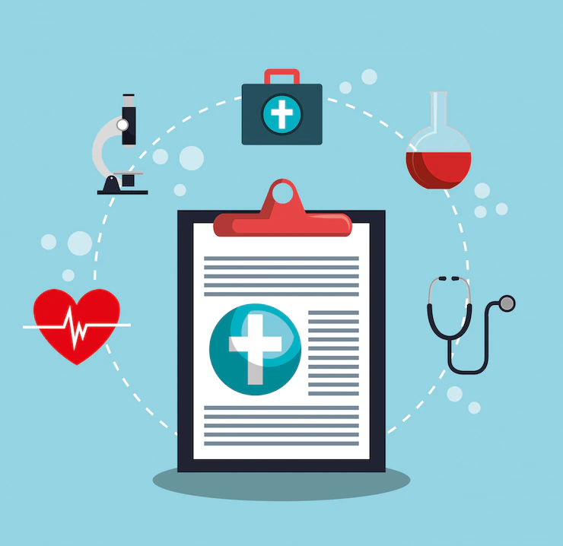
Analytics lab system:
The laboratory is able to open the medical record through the patient's identification card and know the necessary analyzes to be performed.
The patient can also follow the dates of the results of the analyzes through the mobile application.
Also, the analysis specialist cannot change anything in the medical record, but he can add the results of the analyzes to the medical record.

Slide 11

Pharmacy system:
It allows the patient to request his medicine easily through an Identification card that the patient enters, which is a code for his medical record, so that he can know the required medicine and request it from the pharmacy, and he can make a request and it arrives at the patient's home with ease.
The pharmacist is not able to change anything in the patient's medical record, he can only see the medical reports of the medicines.
Note: We also have a stored system to know the deficiencies in the pharmacy and the laboratory, and the ability to request any deficiency in it.

Slide 12
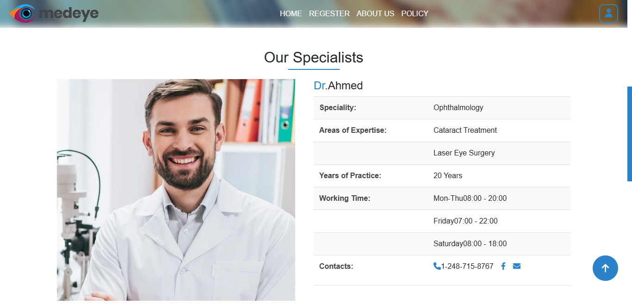
In the first phase
The website is responsible for managing all systems. It has doctors, a pharmacist, an analytics specialist, a nurse and a receptionist, each of whom has a special role

Slide 13
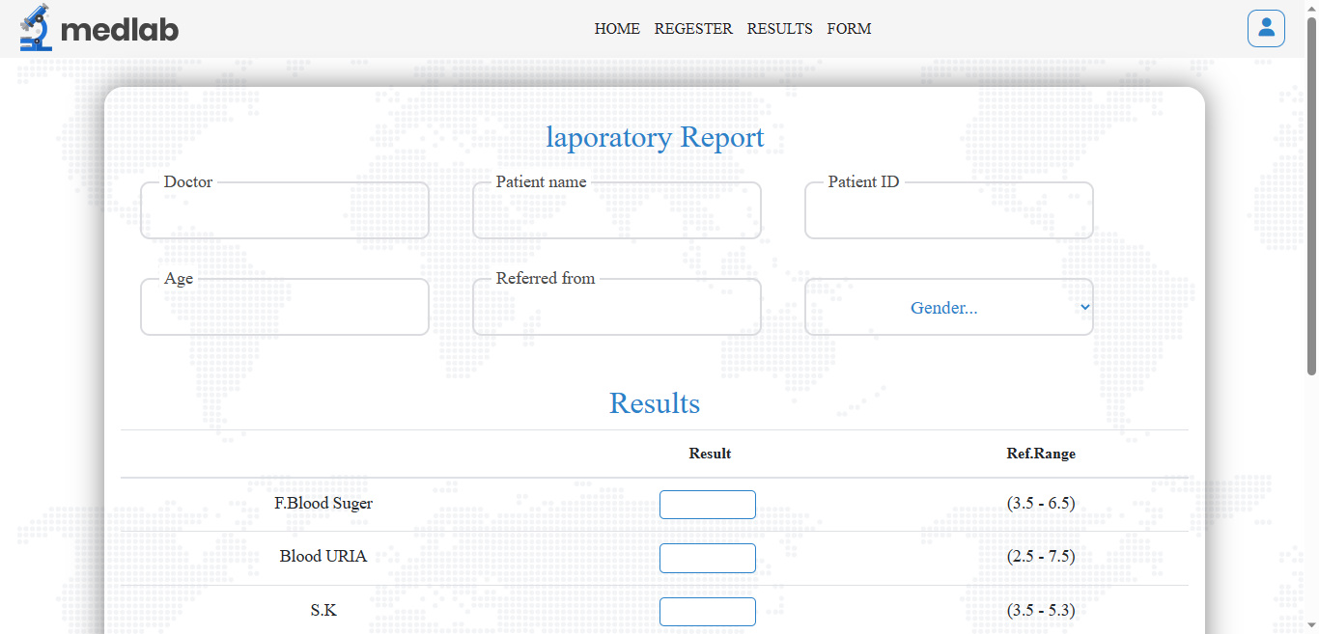
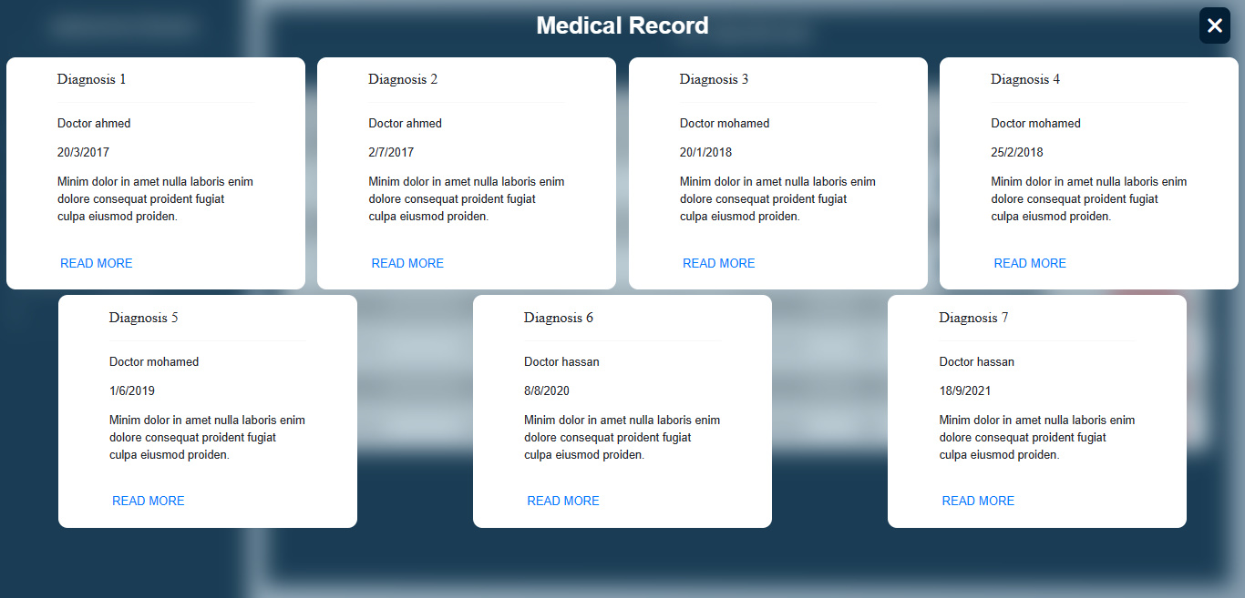
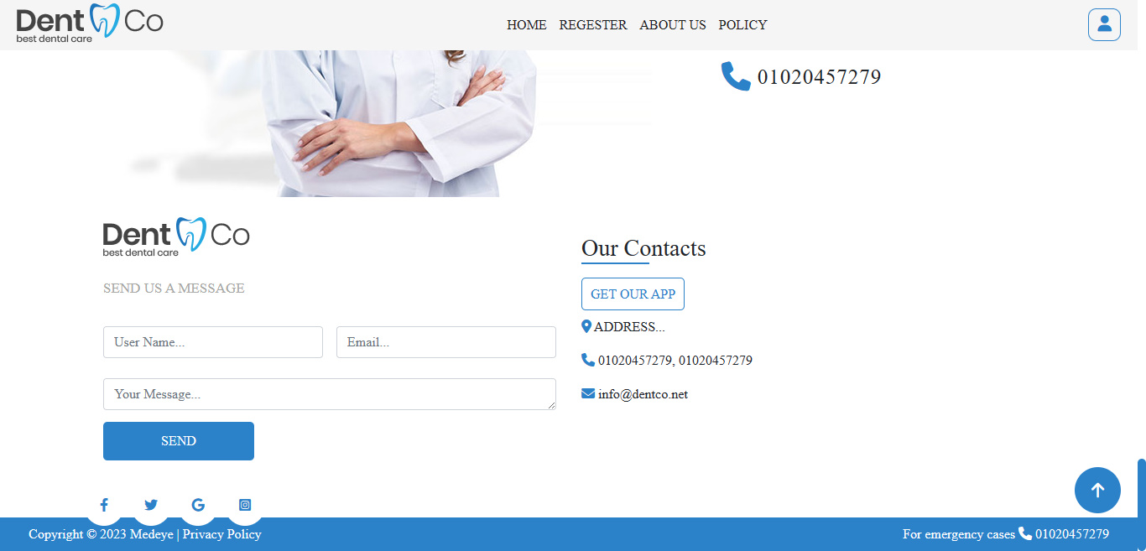
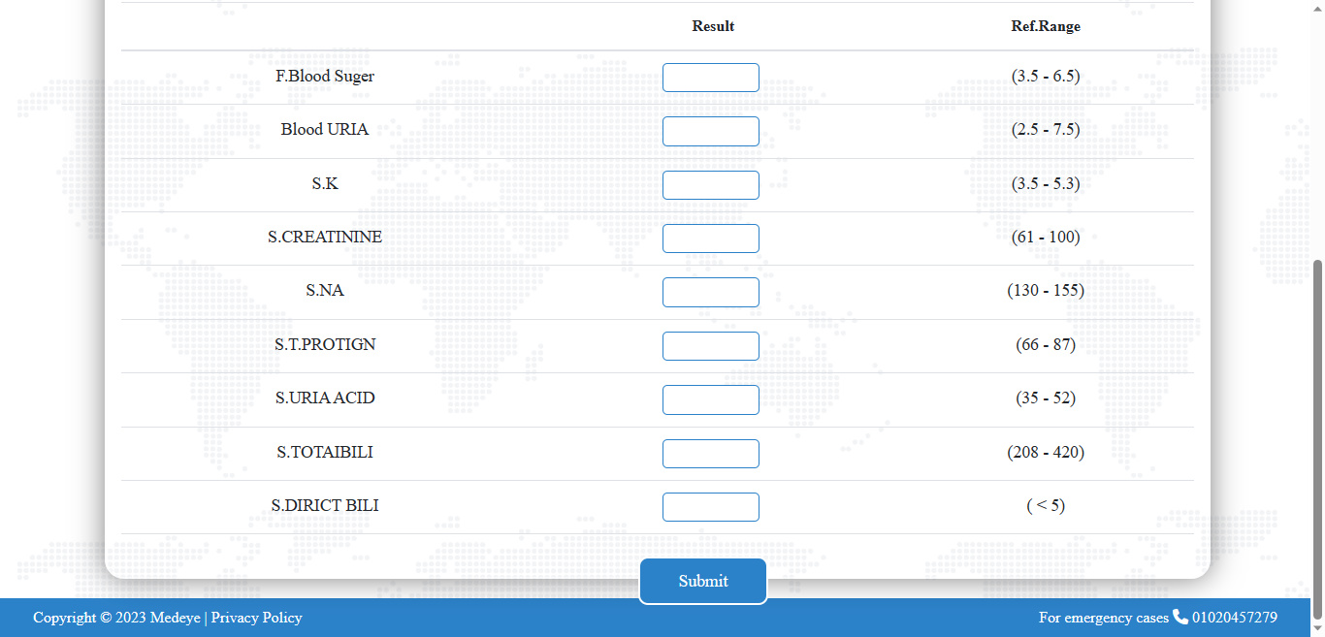
Some website pictures:

Slide 14
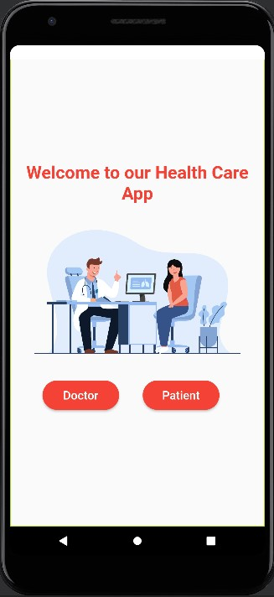
In the second phase
In the mobile application, it allows the doctor to see the medical record and also know his upcoming appointments. As for the patient, he can book an appointment or see his medical record, as well as knowing the results of his analyzes, the date of their appearance, and ordering medicines online through the pharmacy.

Slide 15
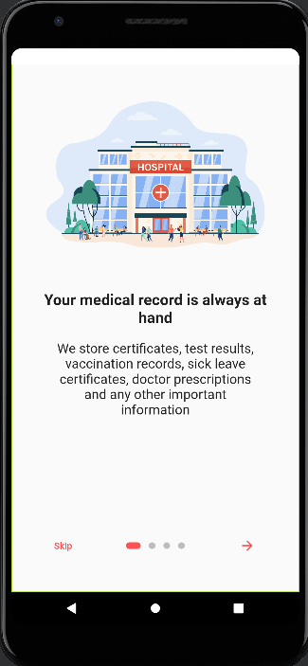
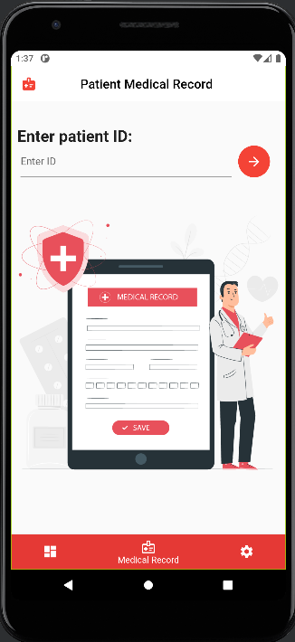
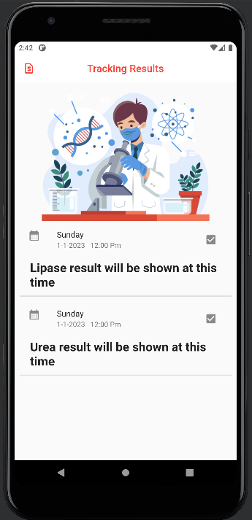
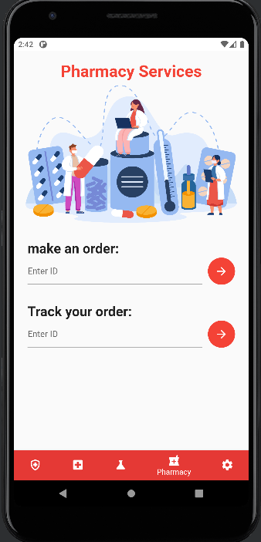
Some pictures of the mobile app:

Slide 16
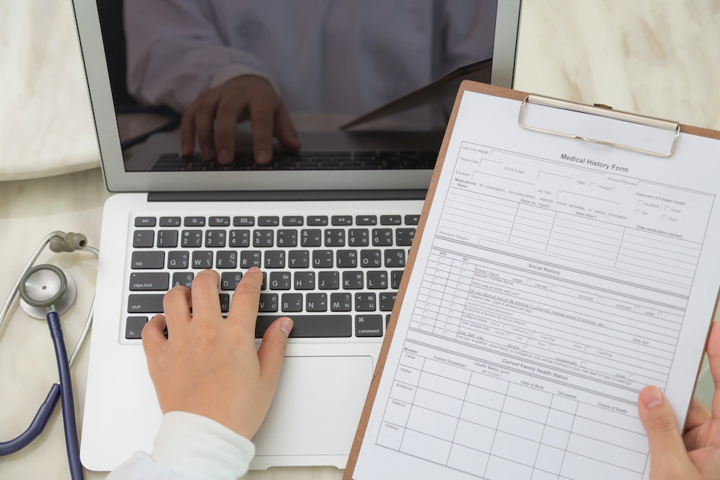
Obstacles we faced:
The inability to convert the paper medical record into an electronic medical record due to the difficulty in not organizing it well.
Security breaches, loss of access to data in the event of a computer crash or power failure, time required to data entry and check its quality, technological complexity, potential for disruption of doctor-patient communication.
lack of support and fast response from hospitals IT staff, and lack of training for health workers in using electronic medical records.

Slide 17
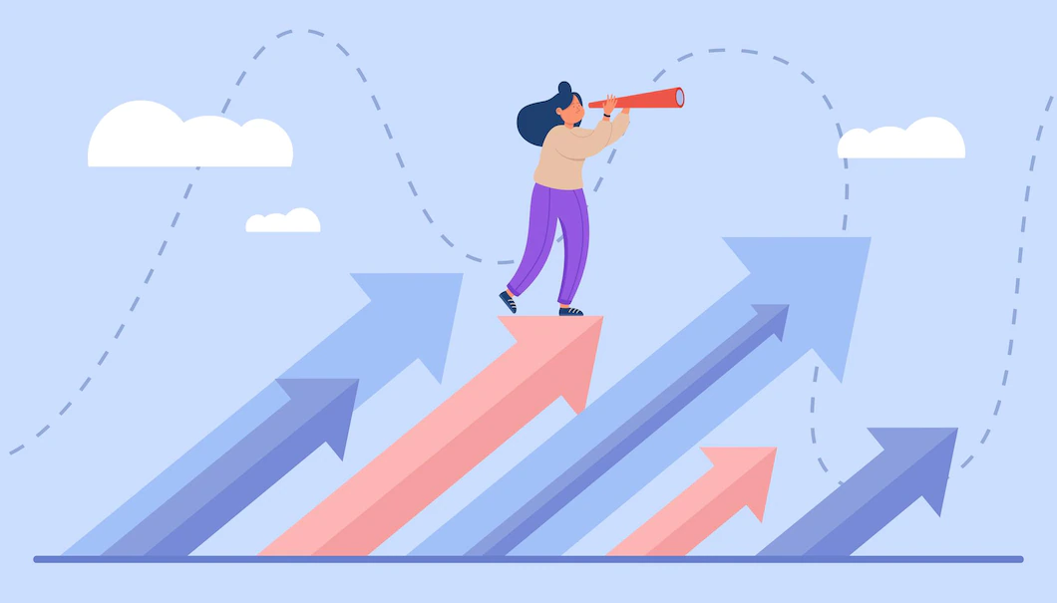
Our future plans:
This project is a good environment for development and updating to improve the user demands as we can:
We connect more than one hospital together so that the patient has multiple options for doctors, and all hospitals have the same medical record.
Linking all medical records together and finding out the percentage of diseases in a specific area and the cause of this disease.
Adding questioning model after every online register to improve quality of the application continuously.
Adding Blockchain Technology as a very secure protection system for patient information.
Conducting courses for doctors and staff working on the system, as well as an explanatory video on how to use the mobile application for patients.

Slide 18
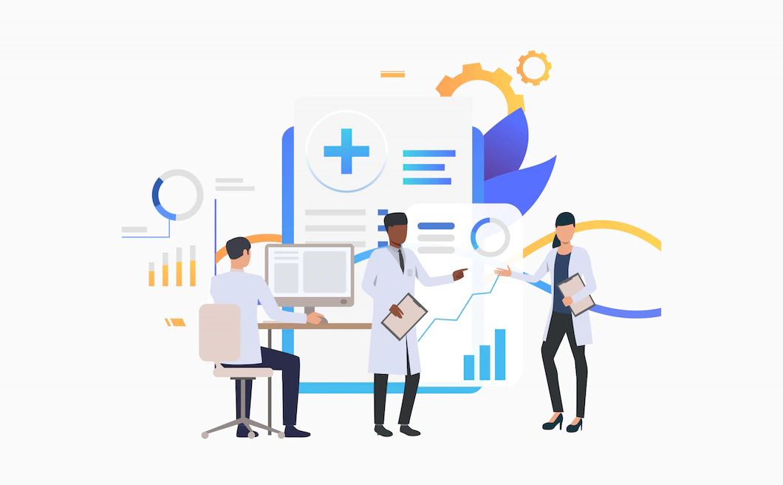
Conclusion:
Is the document that explains all detail about the patient's history, clinical findings, diagnostic test results, pre and postoperative care, patient's progress and medication. If written correctly, notes will support the doctor about the correctness of treatment.
This helps the patients and the doctor as there are many doctors who find it difficult to diagnose, and sometimes they make a wrong diagnosis because there is not enough information about the patient’s previous condition and with this Unified Medical Record it becomes easy for the patient and the doctor to have all the information in one place and a reliable place.

Slide 19
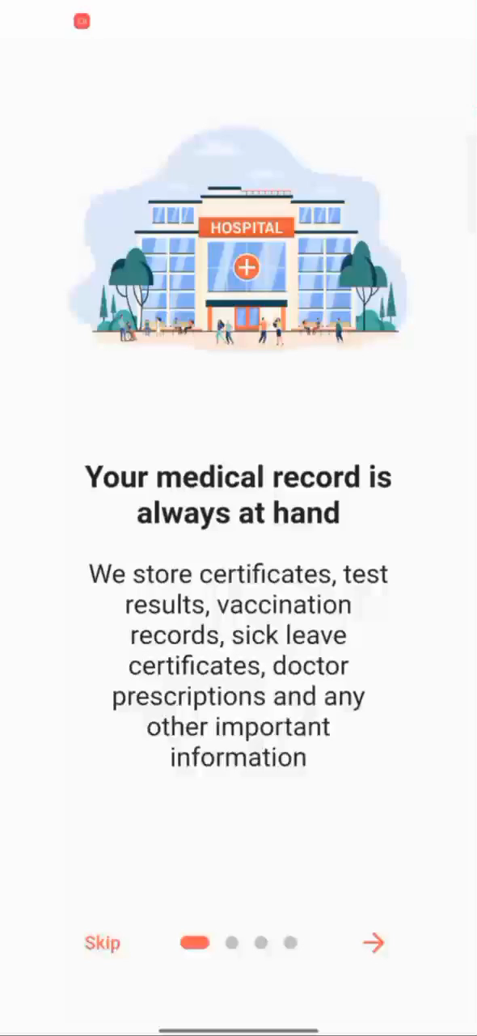
Project video (mobile app):

Slide 20
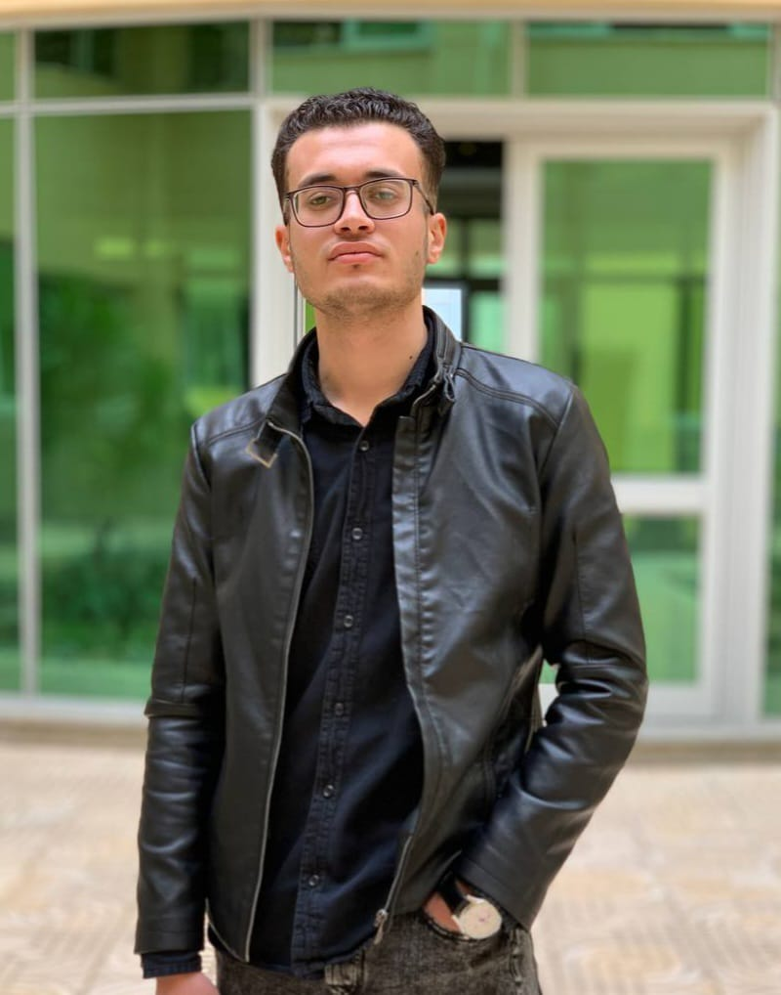


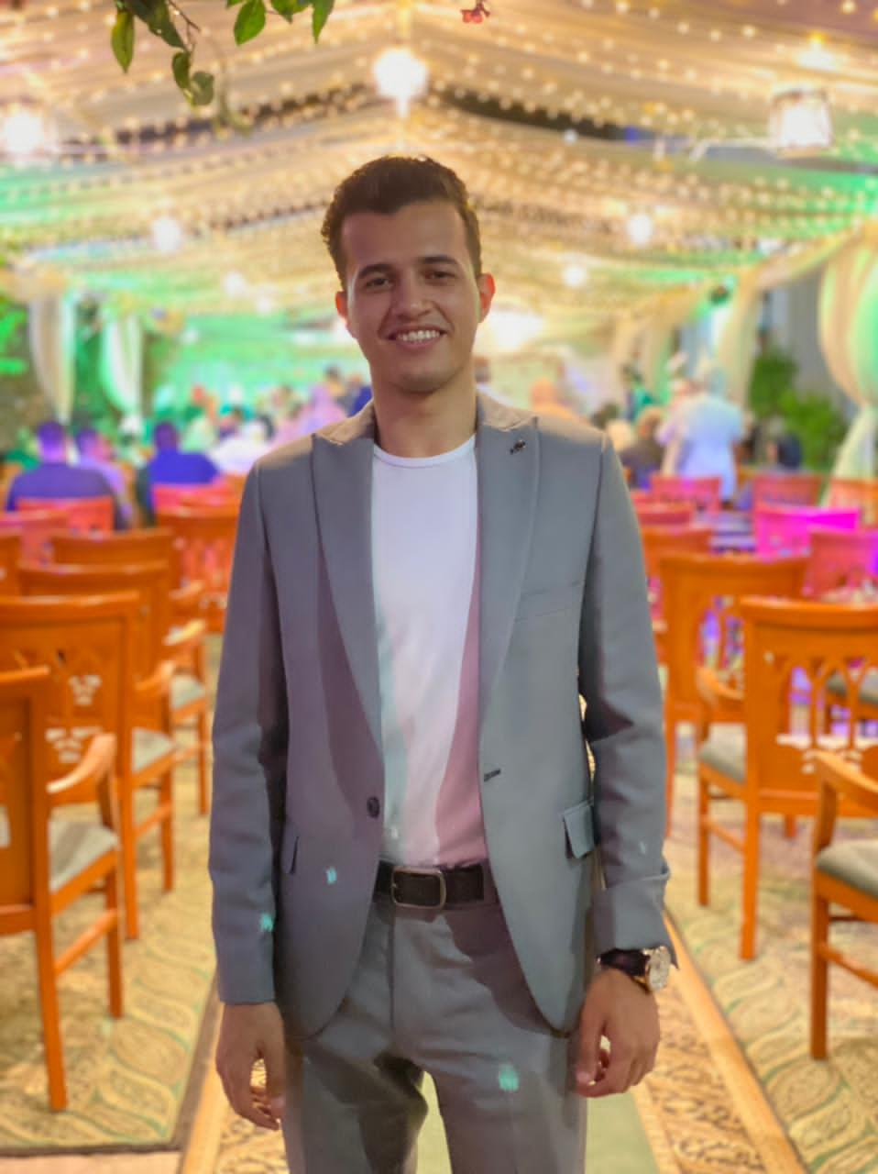
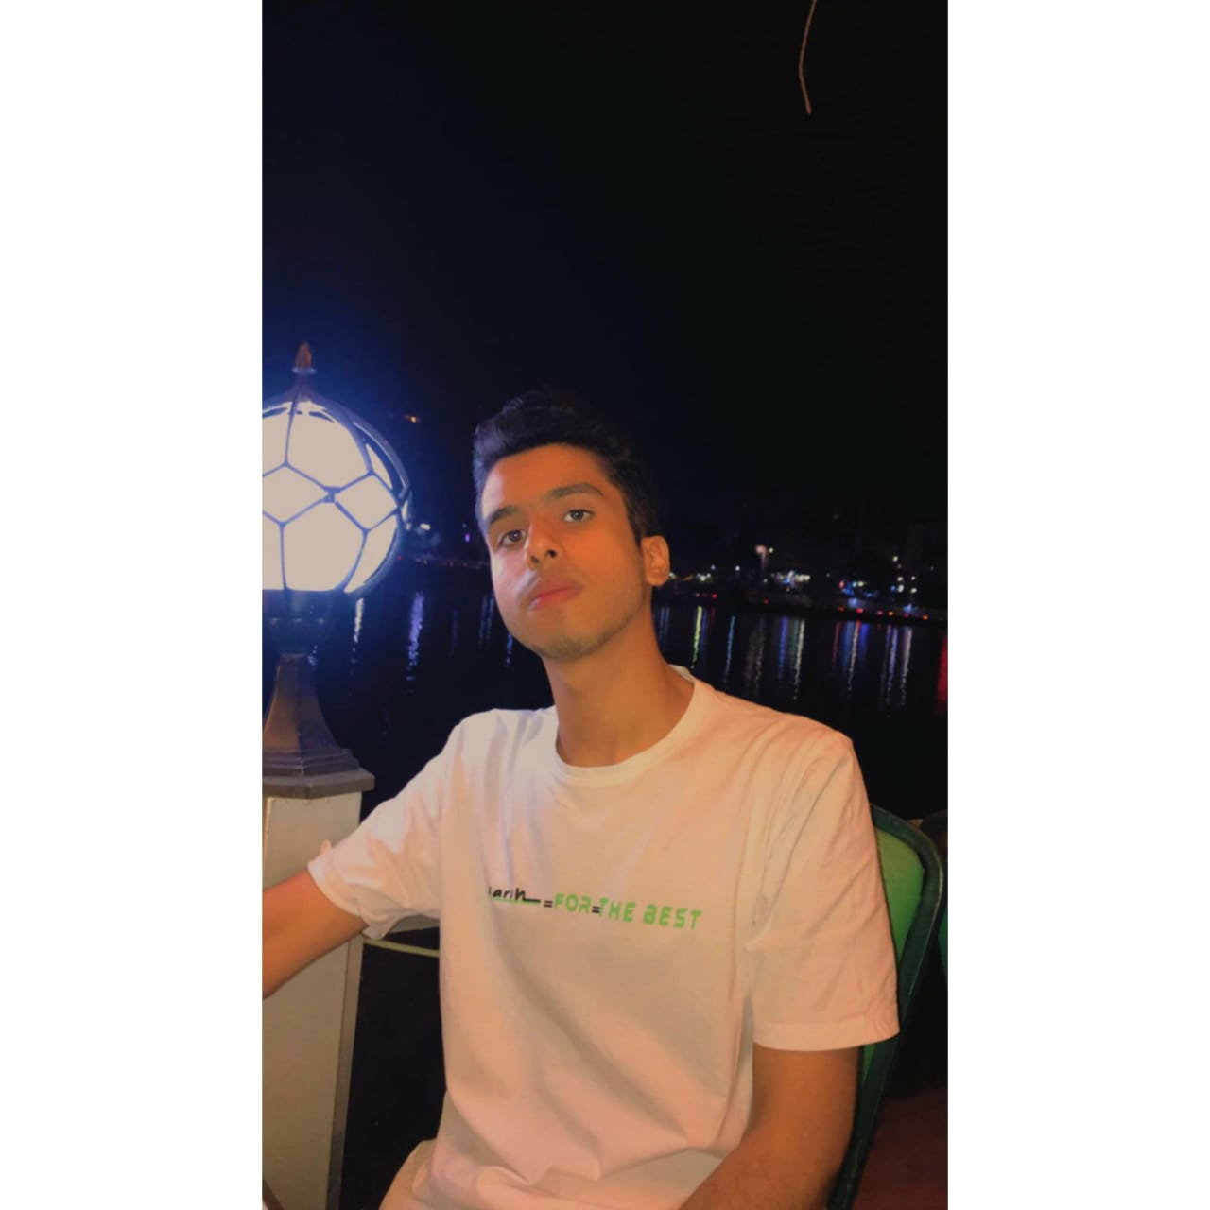
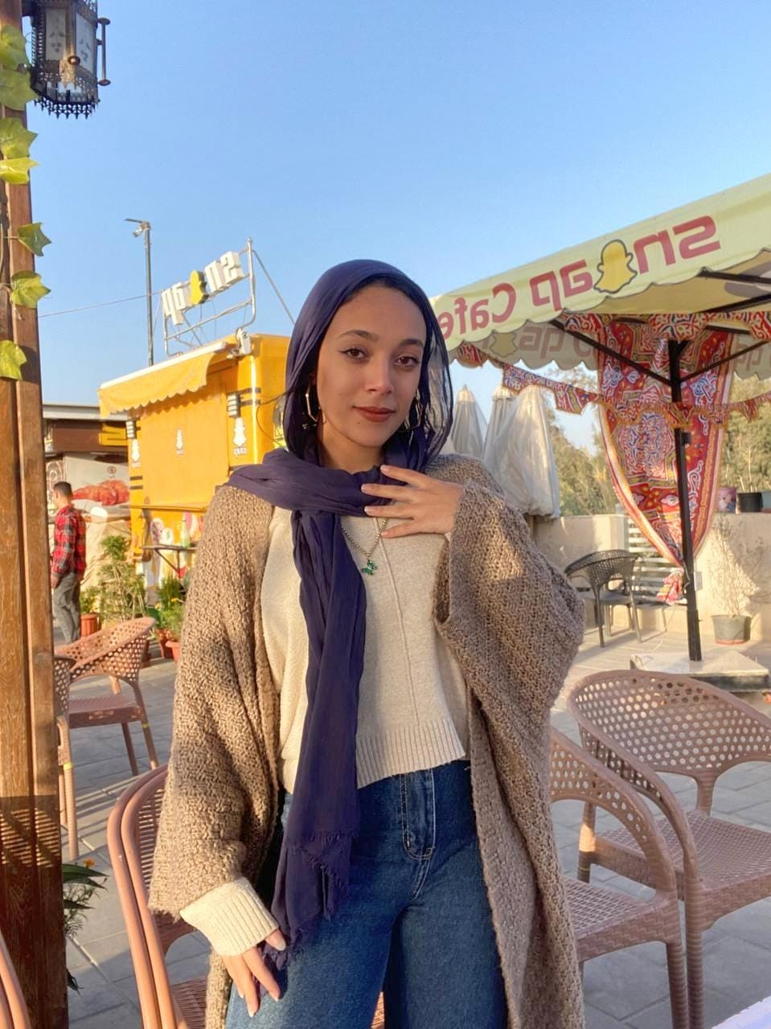
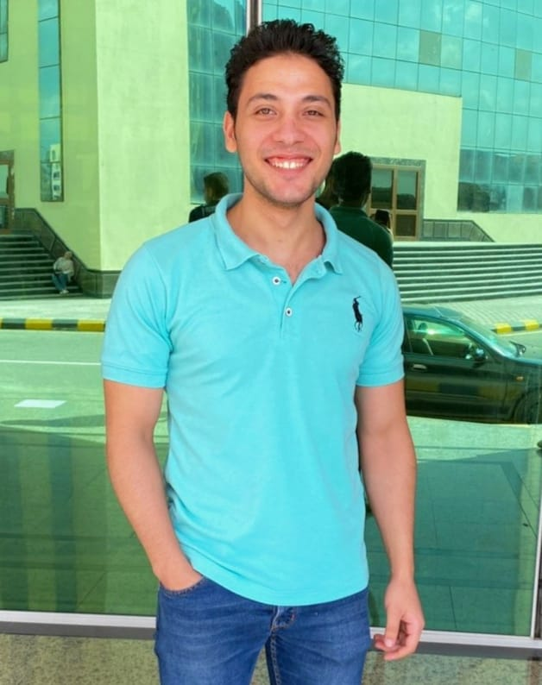
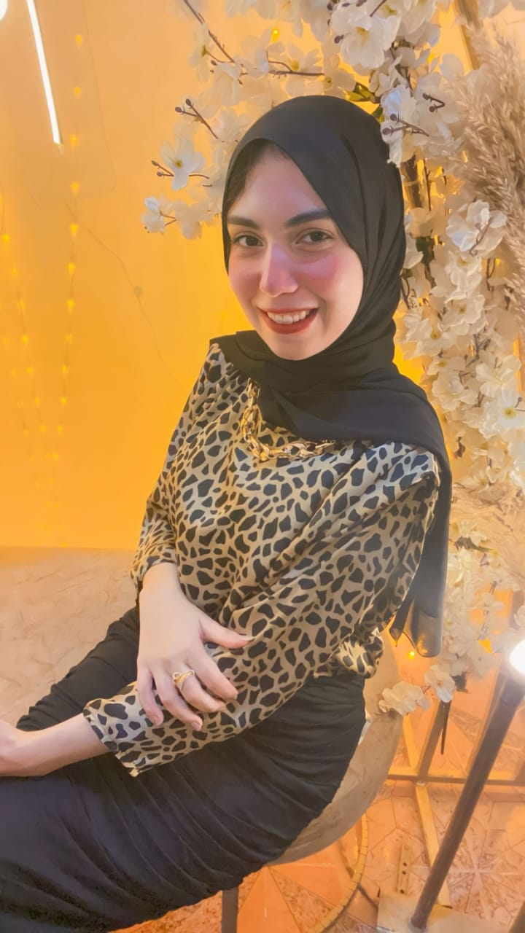
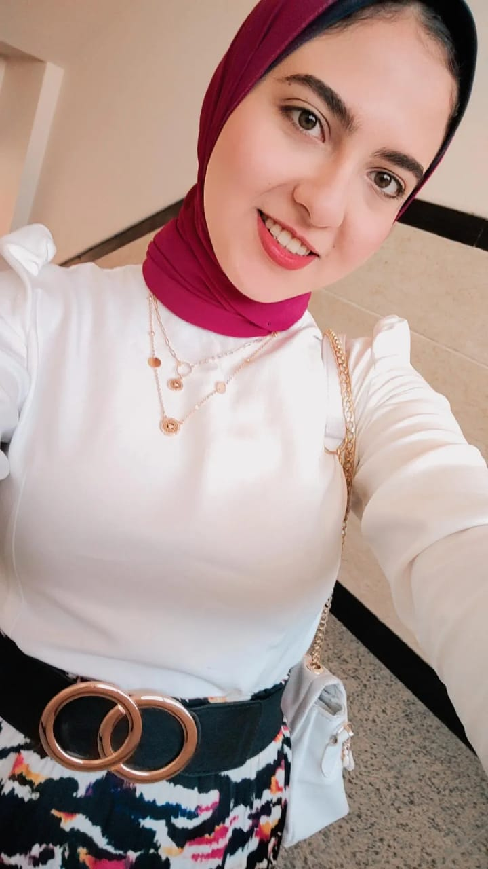
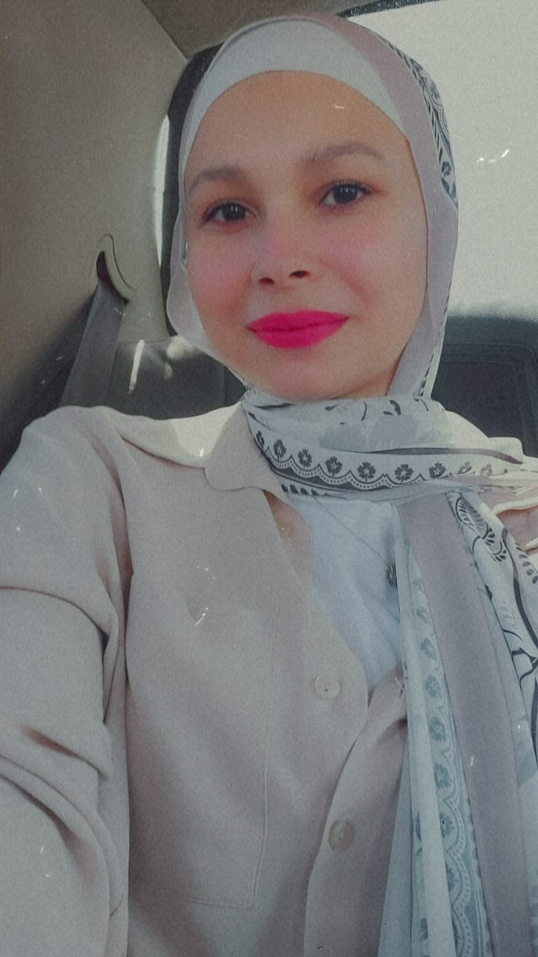
Team Members
Ahmed Fayed
Salma Marey
Hossam Mohamed
Team Leader
Mobile developer
Back-end developer
Ahmed Hassan
Yassmin Bahy
Hassan Zidan
Front-end developer
Back-end developer
Mobile developer
Front-end developer
Amany Ali
Nadeen Medhat
Rawan Ali
Back-end developer
Back-end developer
Front-end developer

Slide 21
Thank You
Under Supervision of
Prof. Dr. Amr Abo Hany

